Slide 1

a
Pronounced as ‘ar’ in English
sagen - to say
fast - nearly
aber - but

Slide 2
a
Pronounced as a short ‘a’ in English
kalt - to say
bis bald - see you soon
nach - after

Slide 3
e
Pronounced as ‘ey’ in English
geben – to give
neben – next to
eben - just

Slide 4
e
Pronounced as a short ‘e’ in English
denken – to give
es gibt – there is
etwas - something

Slide 5
i
Pronounced more like the ‘ear’ sound in English
wir – we
dir – you
mir – me

Slide 6
i
Pronounced as a short ‘i’ in English
finden – to find
fertig – finished/ready
einige – some/a few

Slide 7
0
Pronounced as an ‘oh’ sound in English
wo? – where?
sogar – even
irgendwo - somewhere

Slide 8
0
Pronounced as a short ‘o’ sound in English
Kopf – head
oft – often
oder - or

Slide 9
u
Pronounced as ‘ew’ in English
du – you
Kuh - cow

Slide 10
u
Pronounced as a short ‘uh’ sound in English
Punkt – point
genug – enough
gut - good

Slide 11


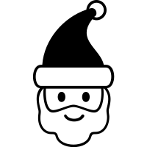
w
Pronounced as a ‘v’ in English
Wasser - water
Winter - winter
Weihnachten - Christmas

Slide 12



v
Pronounced as a ‘f’ in English
viele - many
vier - four
Vogel - bird

Slide 13



z
Pronounced as a ‘ts’ in English
Zimmer - room
Zug - train
Zucker - sugar

Slide 14



j
Pronounced as a ‘yuh’ in English
Jacke - jacket
Jahr - year
Joghurt - yoghurt

Slide 15

ch
Pronounced a bit like the hiss of a cat made with your mouth!
ich - I
nicht - not
mich - me

Slide 16


ch
Pronounced in English like a ‘c’ sound.
Fach - subject
Buch - book
Nacht - night

Slide 17



sch
Pronounced as a ‘shh’ in English
Schule - school
schwimmen - to swim
Dusche - shower

Slide 18



sp
Pronounced as a ‘shp’ in English
Sport - sport
Spinne - spider
Spaß - fun

Slide 19



st
Pronounced as a ‘sht’ in English
Stühle - chairs
Straße - street
stehen - to stand

Slide 20
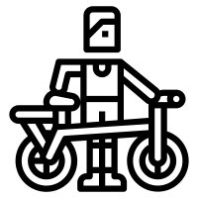

r
The letter r is pronounced differently from English. It is quite a raspy sound like you are gargling water.
rot - red
reiten - to ride
Lehrer - teacher

Slide 21
-d
The letter d is pronounced with a dull ‘d’.
und - and
finden – to find
Hund - dog

Slide 22
ig
The combination is pronounced ‘ish’ in English.
richtig - correct
zwanzig – twenty
viertzig – forty

Slide 23
th
The combination is pronounced as ‘tea-a’ in English.
Theater - theatre

Slide 24



ie
The combination is pronounced ‘ee’ in English.
Biene - bee
Frieden - peace
Lied - song

Slide 25



ei
The combination is pronounced ‘ii’ in English.
Bein - leg
mein - my
Rhein - the river Rhine in Germany

Slide 26



au
The combination is pronounced ‘oww’ in English.
auf - on
augen - eyes
auto - car

Slide 27


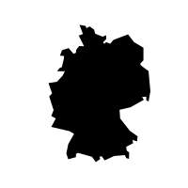
eu
The combination is pronounced ‘oi’ in English.
neun - nine
euro - euro
Deutsch - German

Slide 28

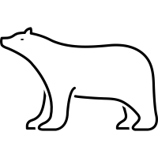


ä
In German, ä is pronounced as an e sound, like in the English word bed.
Bär - bear
Äpfel - apples
Mädchen - girl

Slide 29
äu
In German, äu is pronounced as an ’oi’ sound.
Mäuse – mice
Träume – dreams
Bäume - trees

Slide 30


ö
In German, ö is pronounced as like er. It is similar to the or in word.
schön - beautiful
Löwe - lion

Slide 31



ü
In German, ü is pronounced as oo with pursed lips.
Füße - feet
müde - tired
Brüder - brothers

Slide 32



ß
German has an additional letter, known as the Eszett or scharfes S (sharp S) - ß. It is the same as ss. You use ß when it follows a long vowel or a combination of two vowels.
weiß - white
heißen - to be called
Fuß - foot
Straße - street

Slide 33

ss
When following a short vowel, the ss sound is written as ss instead.
dass - that
bisschen - bit
lassen - to leave

