Slide 1
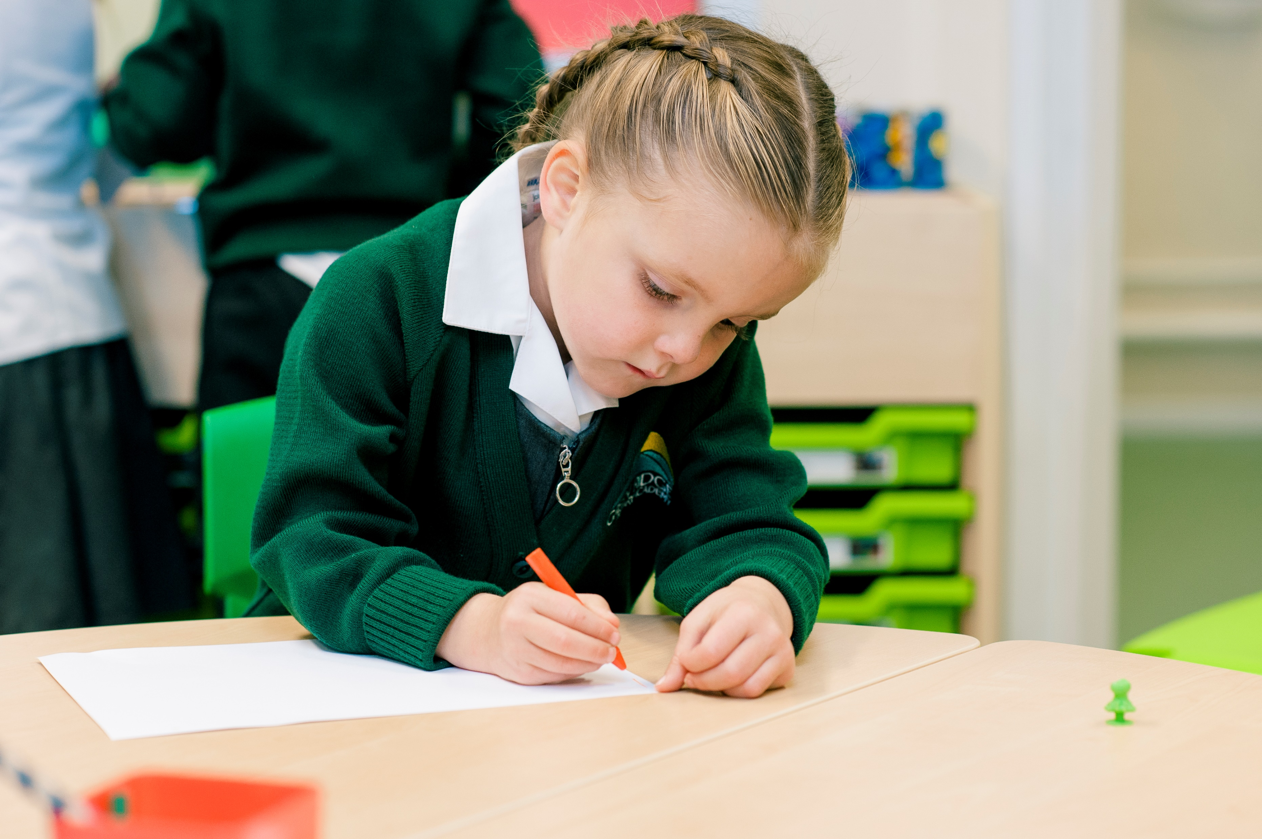
Online Safety Workshop for Parents

Slide 2
Introduction: What do we mean by online safety?
Online Safety is being aware of the nature of the possible threats that you could encounter whilst engaging in activity through the internet
These could be:
Security threats
Protecting and managing your personal data
Online reputation management
Avoiding harmful or illegal content.
What might this look like for children? - https://www.youtube.com/watch?v=funE9tCVu3w&t=4s&ab_channel=UKSaferInternetCentre

Slide 3
Introduction: Online Safety – Why is it important?
The importance of the internet has increased massively in recent years.
This is partially due to remote learning and COVID impact
It is also because of the rise of YouTube (and other social media) which is now more watched than television.
Statistics highlighting the prevalence of online safety issues (Internet Watch Foundation)
79% of children surveyed have experienced online bullying
74% of children surveyed have experienced inappropriate contact
81% of children surveyed have experienced potentially harmful experiences
98% of videos removed from the internet are uploaded by or involve children <13yrs
Teen suicide rates are at an all time high

Slide 4
Apps
Which apps are most commonly used by pupils. These are the top 10 messenging apps/social media apps used by children.

Slide 5
Apps
Which apps are most commonly used by pupils. These are the top 10 messaging apps/social media apps used by children.
Facebook Messenger
YouTube
Instagram
TikTok
Facebook
Discord
Telegram
Snapchat
Whatsapp
Twitter

Slide 6
Apps
What do you think the age-ratings for these apps are?
Facebook Messenger
YouTube
Instagram
TikTok
Facebook
Discord
Telegram
Snapchat
Whatsapp
Twitter

Slide 7
Apps
What do you think the age-ratings for these apps are?
Facebook Messenger - 13
YouTube - 13
Instagram - 13
TikTok - 13
Facebook - 13
Discord - 13
Telegram - 16
Snapchat - 13
Whatsapp - 16
Twitter - 13

Slide 8
Apps
These are generally ‘guidelines’ and the legalities behind these age restrictions are often more vague. However, often it comes down to parents/carers’ permission.
Typically, as a school, we would not advise children to have their own accounts for these apps as the age limits are there for a reason.
However, inevitably some children/families ignore these guidelines. If this is the case, it’s important to know how to keep them safe:
https://www.internetmatters.org/resources/apps-guide/social-networking-and-messaging-apps/#popular-social-apps

Slide 9
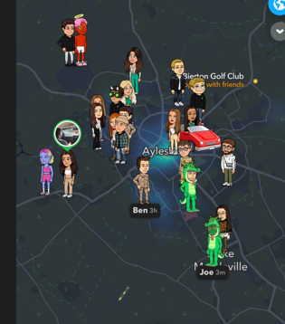
What are the potential risks of social messaging apps to young people?
Chatting with strangers - Meeting and chatting with strangers online poses risks to young people who might be vulnerable to grooming and online (and offline) forms of sexual abuse.
Sending inappropriate content - With the physical barrier of a screen, some people feel more empowered to pressurise others into sending messages, often of a sexual or derogatory nature.
Sharing a location - Many apps work on the basis of your phone location. In many cases apps don’t always let you know that this information is being used, meaning children could be sharing this without knowing.

Slide 10
What are the potential risks of social messaging apps to young people?
Sharing information - Many apps work on the basis of identity or phone number information. In many cases apps don’t always let you know that this information is being used, meaning children could be sharing personal information.
Cyberbullying - Smartphones allow people to take photos and share them instantly on their social networks. This can make young people vulnerable to instances of cyberbullying.
Distortion of Body image - With the rise in popularity of photosharing apps such as Snapchat and Instagram children increasingly feel under pressure to conform so, it’s important to talk about this and help children develop a critical thinking to question what they see online.

Slide 11
What Can we Do to Help?
Engage with your children when they are using devices – explore new apps together
Set clear boundaries (e.g. phone-free zones) and be consistent with these
Encourage them to talk to a trusted adult if they ever have an issue
With primary school children, you should know their account details: let them know from the start that you will be regularly monitoring their devices to ensure they are safe
Use the guides for parental settings (please be mindful that when apps are updated, privacy settings are often reset, so do not forget to check these regularly).

Slide 12
When used safely and responsibly, YouTube provides a wealth of opportunities for children to learn, be entertained, be creative, and play. However, with so much content available – much of which you don’t want your younger children to see.

Slide 13
YouTube – What are the dangers?
https://www.youtube.com/watch?v=oK1v0tGsHxo&t=202s&ab_channel=InternetMatters
Explicit content
A lot of videos uploaded to YouTube contain content that is only appropriate for older age groups. This includes language such as swear words, inappropriate song lyrics, violence, and sexualised behaviour.
Although YouTube does have a policy to remove harmful content that violates their requirements, the sheer volume of videos on the platform means that often inappropriate videos can get missed.

Slide 14
YouTube – What are the dangers?
Cyber bullying though YouTube comments
The comments section on YouTube can often be a place of negativity, where people share hateful comments towards each other.
These can be directed at the video creator or directed to another user who has written a comment. Like other social media platforms, YouTube provides the ability to reply to comments in a thread (which is often where arguments in comments begin).

Slide 15
YouTube – What are the dangers?
Related videos
On the right-hand pane of the screen (on a laptop or computer), or below the video (on a small portable device), YouTube offers suggested videos to its users. This means that YouTube will suggest similar videos for you to watch next. Although this may seem helpful, YouTube does not always get this correct and may suggest other “off topic” videos that can lead to more inappropriate videos being found.
YouTube also has a function to “auto play” the next video, which can easily get users hooked into watching hours of videos in one sitting.

Slide 16
YouTube – What are the dangers?
Challenge videos
There are often trends that circulate social media that encourage users to complete challenges. The challenges can be extremely harmful, and some videos can even target children specifically.
Misinformation
YouTube, as with many social media apps, can be home to a lot of fake news or misinformation. The younger generation are increasingly likely to turn to their favourite YouTubers or influencers for their views on what is happening in the world; but content creators on YouTube cannot be classed as reputable sources.

Slide 17
YouTube – What can we do to help?
YouTube Kids – You can set YouTube Kids up as a parent which effectively means that you can share your child’s account and have more assurance over what content they have access to. YouTube Kids has built-in filters to ensure that all content available is age appropriate and safe for your child. You just need to add your email address to create an account.
Watch videos with them – One of the best ways to understand how your child uses social media is to use it with them as an activity to do together. Instead of watching television together, you can ask your child to put on their favourite YouTuber
Check their history – If you have access to your child’s YouTube account, you can check their watch history. This is a list of previously watched videos that your child has viewed. You can check these to ensure the videos are safe for your child to view.

Slide 18
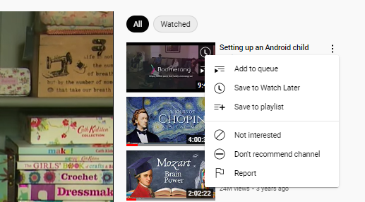
YouTube – What can we do to help?
Tailor the suggested videos – The suggested videos on YouTube are calculated using an algorithm. This means that the wrong type of content can be shown in the suggested list. If you or your child ever notices inappropriate videos in this list, you can click on the three dots next to the video in question, and select “not interested”, which will remove the video from the list.
Private profiles – If your child is uploading content onto YouTube, they can make their profile private, which means that only those they invite can view their video and it will not be made public. This reduces the risk of hateful comments being left on their video.

Slide 19
Video Games
Children love playing video games both offline and online but how can we ensure they are playing appropriate games?
PEGI – a European video game content ranking system (age ratings and game descriptors)
https://www.youtube.com/watch?v=r7KOp56oNO8&t=104s

Slide 20
PEGI Ratings vs Laws
PEGI ratings are ultimately there to support you (as parents/carers)
By allowing children to play a game when they are younger than the PEGI rating, no laws are being broken, however the children are not allowed to purchase the game themselves
With that said, the PEGI ratings are set by gaming experts who use their experience and judgement, alongside other experts and we highly encourage you to follow them as closely as you can
It is important to note that PEGI ratings also consider the level of communication available online which is critical for primary school children

Slide 21
Popular Games and their PEGI Ratings
Have a guess what the PEGI ratings are for the following games:
Roblox 7+
Minecraft 7+
Fortnite 12+
Among US 7+
Five Nights at Freddy’s 12+
Crossy Road 9+
Call of Duty 18+
GTA 18+
https://pegi.info/

Slide 22
Popular Games and their PEGI Ratings
Have a guess what the PEGI ratings are for the following games:
Roblox 7+
Minecraft 7+
Fortnite 12+
Among US 7+
Five Nights at Freddy’s 12+
Crossy Road 9+
Call of Duty 18+
GTA 18+
https://pegi.info/

Slide 23
Looking Beyond the PEGI Rating
The PEGI ratings are there to guide you, however you may want to explore them for yourselves first
If you Youtube the game, you can see reviews or actual gameplay – this is the best way to determine whether it is appropriate for your child
Do not be influenced by what other parents allow/don’t allow. It is easy to seek advice from another friend but, ultimately, we all have our own values and opinions on things, so we would recommend exploring it for yourself

Slide 24
Video Games – Time to Switch Off
“Two more minutes!”
“I just need to finish this level!”
“Jake is still playing, why do I have to stop?”
We are sure you have heard all of the excuses in the world - how can we encourage children to stop playing games when we want them to?
Setting clear expectations/guidelines: when/what/how long
Be consistent and follow through with any consequences
Give timer reminders: 10, 5 and 2 minutes forewarning
Use time settings on your devices – automatically stop games when the time runs out

Slide 25
Video Games – Applying Settings
https://www.internetmatters.org/parental-controls/gaming-consoles/
If you would like a specific guide printed or emailed, please make ask me at the end.

Slide 26
Cyberbullying – What is it?
Cyberbullying is defined as a form of bullying or harassment through electronic means.
Examples include:
sending mean messages via text, social media or within a game;
pranking someone’s phone;
repeatedly ‘hacking’ someone;
using unkind language to someone online;
pretending to be someone else to spread rumours;
posting private pictures or messages online with consent;
using websites to judge people;
verbally abusing other players in an online game;
using multimedia to create hurtful/offensive pictures/jokes/memes etc.

Slide 27
Cyberbullying: How Can we Identify it?
Your child all of a sudden doesn’t want to spend any time of their favourite device
They are quieter and/or less responsive after using an electronic device - withdrawn
They seem irate or upset
Not playing with someone they usually play with
Not wanting to come into school or play outside with friends they normally do
Unwilling to share any information about their accounts
Headaches, stomach-aches, vomiting, trouble sleeping
Making passing statements about their life that are obvious red flags

Slide 28
What Can we Do to Help?
https://www.internetmatters.org/issues/cyberbullying/
Be non-judgemental, open and honest
Let them know that you are always there to talk, even if they have made the wrong choice to begin with
With primary school children, you should know their account details: let them know from the start that you will be regularly monitoring their devices to ensure they are safe
Look at the ‘conversation starters’ handout if you want further advice at approaching such a difficult subject

