Slide 1
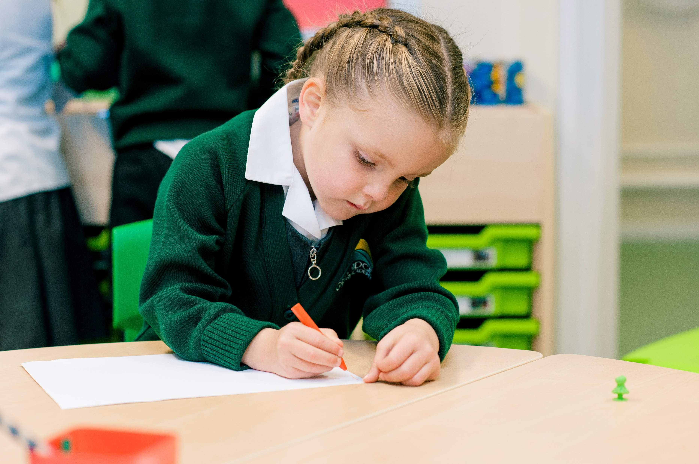


Green Ridge Primary Academy
Reception Parent Induction Session
Starting School September 2020

Slide 2
The Early Years Team
Reception Team
Mrs Nikki Mackie – Assistant Headteacher, Early Years
Class teachers and support staff to be confirmed at a later date.

Slide 3
What’s in your pack?
Class Name and House group letter- this will be sent out later this term
Admissions Form
Pupil Premium/Free School Meal registration form
EYFS Parent Handbook
Consent Form Booklet
Collecting your child permission form
‘What to expect when’ – Early Years outcome expectations
Early Learning Goals – Expected Standards
Year R Curriculum Overview 2020/2021
Busy Living Parent Handbook
Herts Catering Limited Menu
School Milk Letter
Term Dates
The Road to School Poster
Green Ridge Travel Leaflet
Parent Evaluation Form

Slide 4
Academy Uniform
Which uniform should my child wear in September?
Either Winter or Summer uniform is acceptable until October half term. Winter uniform is worn from October half-term until Easter and summer uniform is worn from Easter until half-term in the autumn term.
Winter Uniform
White shirt & School Tie (or option to wear white blouse) | White Blouse (or option to wear white shirt with school tie)
Grey trousers | Grey skirt or tunic/pinafore
Green V-neck jumper with logo | Green cardigan or jumper with logo
Grey, White or Black socks | Grey or white socks or grey tights
Green academy fleece (optional – not to replace jumper) | Outdoor coat
Book bag | Black sensible shoes (no raised heels, boots or trainers)

Slide 5
Academy Uniform
Summer Uniform
Grey trousers or Grey shorts | Green check dress (gingham)
White shirt & School Tie (or option to wear white blouse) | White Blouse (or option to wear white shirt with school tie)
Green V-neck jumper with logo | Green cardigan or jumper with logo
Green academy fleece (optional – not to replace jumper) | Grey skirt
Grey, White or Black socks | Legionnaire/baseball hat
Black sensible shoes (no raised heels, boots or trainers) | Book bag

Slide 6
Academy Uniform
PE Kit
Children will need their PE kit in school at the start of the term.
House coloured T-shirt
Black shorts (cycling shorts or shadow-type)
Trainers (not plimsols)

Slide 7
Academy Uniform
Hair
Please can you make sure your child’s long hair is always tied back with hairbands which blend in with the colours of the academy uniform (green, grey, black or white). Girls are kindly requested not to wear coloured bows or flowered hairbands.
We ask that any children who wear head coverings (e.g. a hijab) ensure this is plain black in colour.
Non-uniform – but important
A pair of wellies, clearly named
A waterproof with a hood – even in summer – the children play outside whatever the weather and they need to have appropriate outdoor clothing
A warm coat, mittens, hat and scarf for when it is cold
Sun cream – make sure you have applied sun cream to your child in the morning before they come to school in hot, sunny weather
Remember to name everything!

Slide 8
Site Layout
Plane (Y2)
Oak (Y2)
Cedar (Y3)
Rowan (Y4)
Birch (YR)
Little Berries
Elm (Y1)
Main Entrance
Beech (Y1)
Willow (YR)
Little Acorns

Slide 9
How will transition happen this year?
Our aim is to ensure children are as settled and ready for school as possible, however this is going to be a challenge this year. As we are not able to run the transition sessions as planned we will continue to do a range of things to support a smooth start to school.
Tapestry- please ensure you have signed the consent form for this and returned to school.
Tapestry- we will shortly be sending an activation email, please activate your account and download the app to your phone. (if your child is currently in nursery at Green Ridge their account will just carry on into YR)
  We will be using Tapestry as our main transition tool this year.
  We will use it to upload videos of the school, environment, staff and other things so please try to encourage your child to watch the videos so they can get to know us.
  We would love to see some videos of the children at home uploaded so we can also get to know them.
  The videos can be of anything; them talking, counting, looking at books, playing with family- they will all help us to get to know the children.
  We will not be replying individually to anything uploaded so if there are specific questions please email the school on admin@greenridgeacademy.co.uk

Slide 10
How will transition happen this year?
Look at our YouTube Channel as there are lots of other staff videos and assemblies by Mr Wanford and Mr English, these will help the children get to know key members of staff.
Instead of home visits we will arrange a phone call discussion with you to talk about any other worries/ concerns in advance of your child starting.
Above all else please try not to worry about the time your child may have missed from nursery or how they will settle in. Getting the children settled will be our absolute priority and we will be here to support you and your child through any worries.
The stay and play sessions we would normally hold during the summer term are unable to happen. We plan to reschedule these for the start of the Autumn Term.

Slide 11
Over the Summer Holidays- The Road to School
Let your child be involved (if possible) in buying the academy uniform. Practise dressing and undressing into and out of the uniform and PE Kits so they are comfortable doing this independently. (Do the same with shoes and wellie boots)
If they still need help with toileting, please practise increasing their independence in this area.
Share plenty of stories, foster a love of reading.
Count - steps, spoonfuls of food, cars - anything that can be counted!
Ensure your child is comfortable recognising their name.
Work with your child so that they are comfortable holding a pencil correctly, e.g. focusing on mark making
Develop their fine motor skills further: use of tweezers, scissors, playdough, cutting paper etc.
Talk to your child about lunch times. If they are packed lunch, discuss what they would like and if they are having hot meals, have a look at the menus together.
We focus highly on communication and language. It would be great if you could encourage your child to speak in full sentences and answer in full sentences.

Slide 12
The first few weeks – settling in
Week 1 (w/c 31st August)
Monday – (Summer break - academy closed)
Tuesday – (INSET day- academy closed)
Wednesday 2nd September- term starts.
The start of school is likely to look different this year. Currently we will be planning a start for the children that follows these steps:
  Stay and Play Sessions x 3
  Half children complete a morning (Group 1), half complete an afternoon (Group 2)
  Half children complete a morning (Group 2), half complete an afternoon (Group 1)
  All children stay for the morning and have lunch, then go home
  Children will then be in school full time.
** Further information about the start of Autumn will follow later this term**

Slide 13
What to expect…
Open door policy. Please come into Reception with your child to help them hang coats, put book bags/water bottles away and settle them at their ‘busy fingers’ activity. Please let adults know anything you feel is important.
We quickly work towards the children becoming independent.
We encourage them to be independent when choosing their lunch – please talk to your child about the menu.
Expect phonic sound cards to be sent home.
Your child will probably be very tired the first few weeks (especially after the last few months).
Reading books will be sent home as each child is ready, and following the Phonics/Reading workshop taking place at the start of term. More information will be given here about what the expectations for reading are and how the book-band system works at Green Ridge.

Slide 14
The Early Years Curriculum
We will be following the Early Years Foundation Stage curriculum. There a big emphasis on ensuring that the foundations for further learning are developed.
Prime areas are:
Personal, Social and Emotional Development
Communication and Language; and
Physical Development.
Specific areas are:
Literacy
Mathematics
Understanding the World; and
Expressive Arts and Design.
Child Initiated Learning – where children are encouraged to learn through exploration and play. The timetable reflects this with a mix of adult directed and child initiated learning.
Learning will happen outdoors as well as in. Please ensure you child is prepared for any weather – hot or cold!

Slide 15
Characteristics of Effective Learning
Playing and exploring
Finding out and exploring
Playing with what they know
Being willing to ‘have a go.’
Active learning
Being involved and concentrating
Keeping trying
Enjoying achieving what they set out to do
Creating and thinking critically
Having their own ideas
Making links
Choosing ways to do things

Slide 16
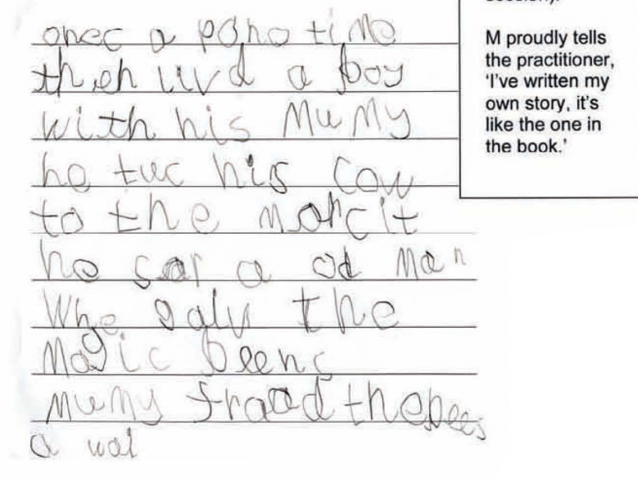
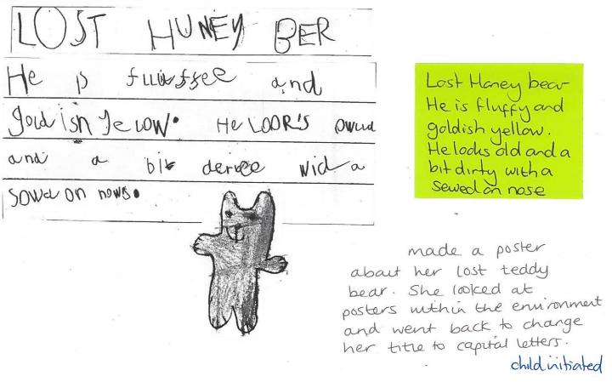
Where should my child be by the end of Reception?

Slide 17
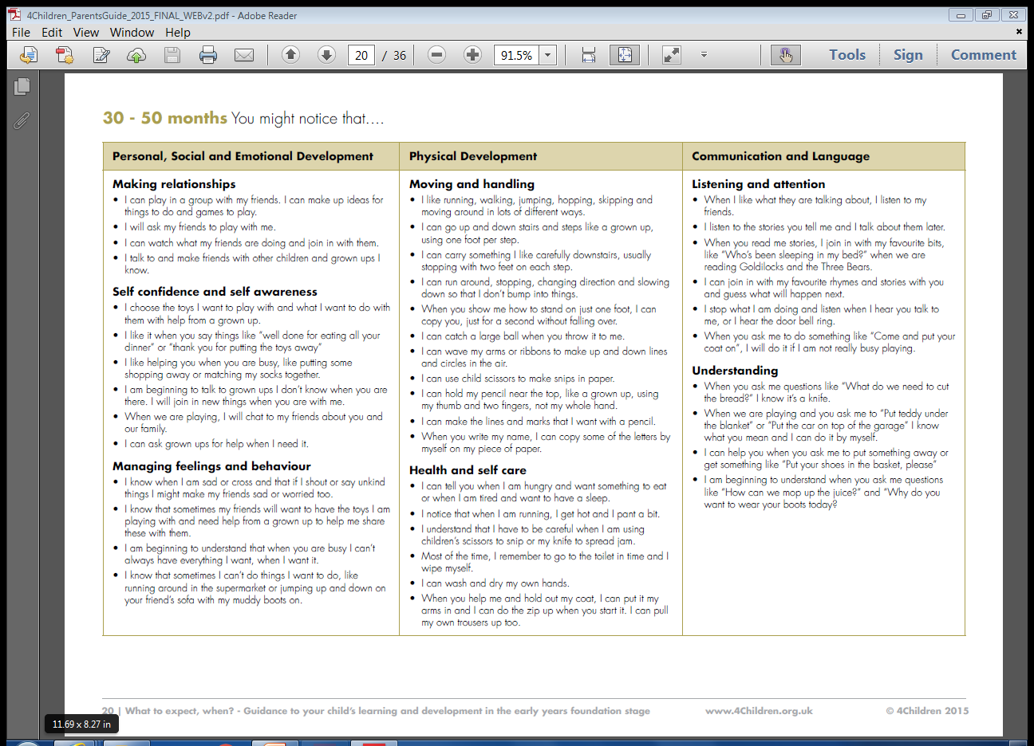
What to expect when…

Slide 18
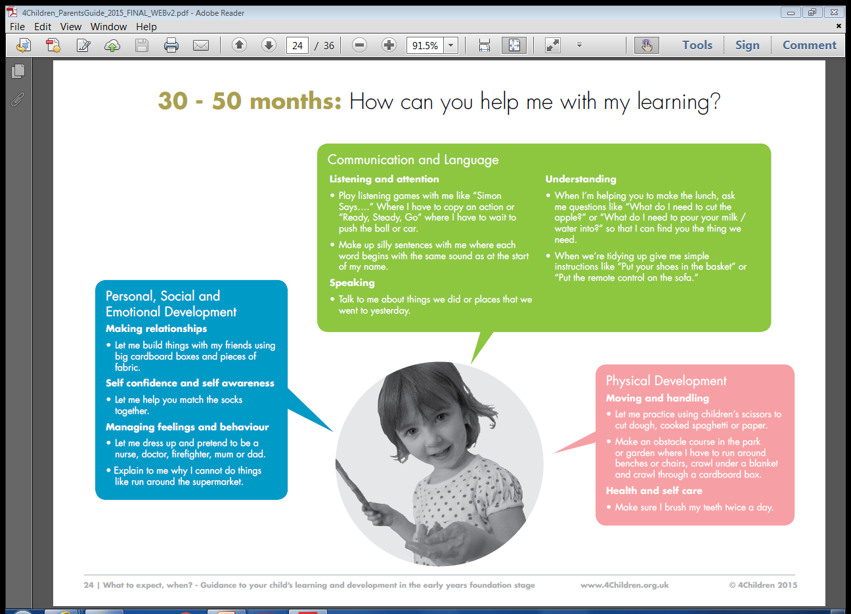

Slide 19
A day in the life of a Reception child
If this is not a familiar conversation it soon will be!
Parent: “What did you do at school today?”
Child: “Just played.”

Slide 21

What does a day look like in Reception?
Morning
Busy fingers/Morning Activity
Welcome and good morning
Phonics (teaching of Reading and Writing)
Carpet time – Literacy (including Talk4Writing)/Topic based
Child Initiated Learning (CIL) (snack available – milk/water fruit and vegetables)
Afternoon
Carpet time – Maths
Child Initiated Learning (CIL)
Helicopter Stories/Story-time
Children will take part in adult-directed activities as part of their daily focused teaching, and adults will do this during CIL, so that it follows your child’s interests.
We will aim to listen to your child read individually each week (by the Class Teacher or TA).
Please ensure your child attends school punctually at the start of the day, and is collected promptly. This can be an anxious time for children!

Slide 22
Reading
Develops a love of reading
Part of a bedtime routine
Encourage stories at all times of the day
Model reading enjoyment yourselves
Role models of all genders and ages would be great
Join a library and make time to borrow books
Phonics Parents Workshop:
Autumn Term- date TBC
Take a look at: http://www.ruthmiskin.com/en/resources/sound-pronunciation-guide/

Slide 23
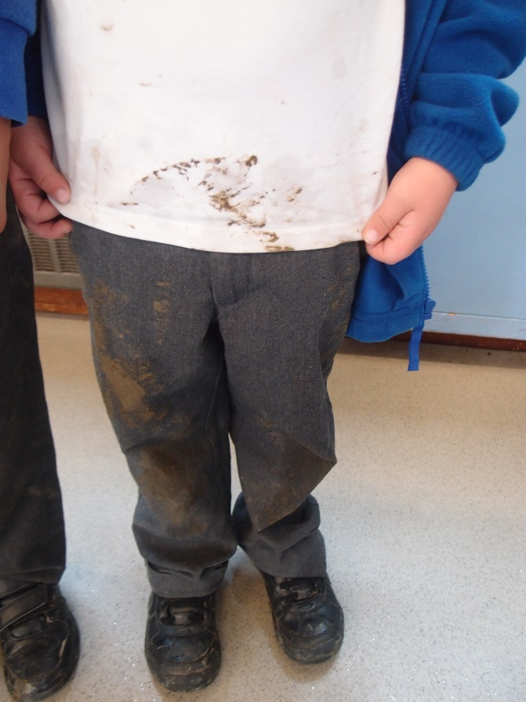
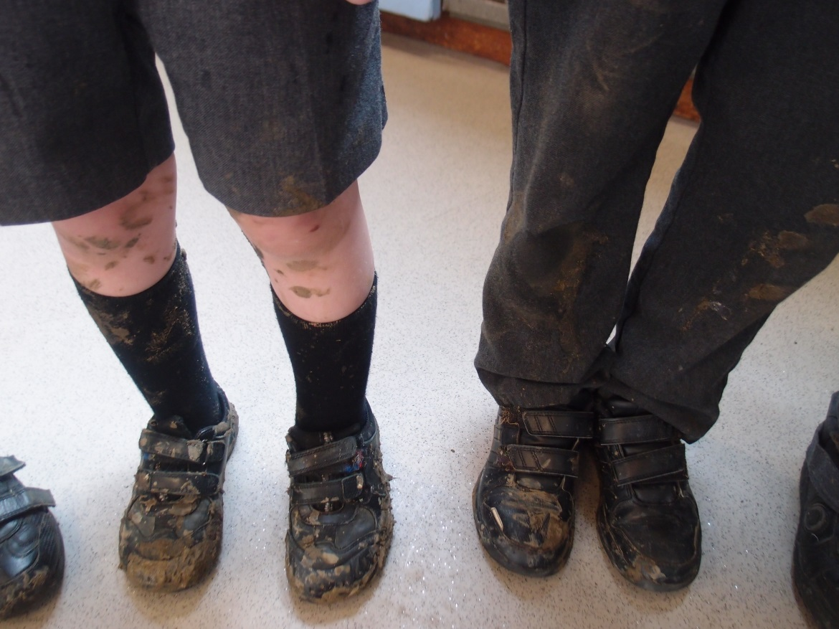
Mud, mud glorious mud
“So let your child be a child. Dirt is good. If your child isn’t coming in dirty every day, they’re not doing their job. They’re not building their immunological army. So it’s terribly important.”

Slide 24
What does my child need to bring?
Book bag (Reading record and reading book)
Water bottle
Appropriate clothing for weather
Wellie boots to be kept at school (if possible)
PE kit with coloured t-shirt (linked to house name)
Please do not let your child bring in toys or personal belongings unless we specifically ask!
Please ensure EVERYTHING is named!

Slide 25
Parents/Carers as Partners
Important to communicate – About anything we may need to know.
Reading – Daily with your child.
Learning Journal – Tapestry.
Home Learning – Reading scheme books and Phonic flashcards will come home.
Regular events – throughout the year parents are invited into school – parent workshops, ‘Stay and Play’, open evenings and events such as the Christmas Play and Sports Day.
Volunteers
PTA
Notes:
QUOTE: ‘Good parenting and high quality early learning together provide the foundation children need to make the most of their abilities and talents as they grow up.’ EYFS Statutory Framework

Slide 26
Questions?

